Slide 1








Slide 2

The dataset contains COVID-19 statistics for 36 states in india, including 12 columns:
01
State/UTs
The name of the state in india, where there is 38 state.
02
Zone
The classification of the regio.
03
Total Cases
The total number of recorded cases.

Slide 3
04
Active
The number of currently active cases.
05
Discharged The number of recovered or
discharged cases.
06
Deaths
The total number of deaths.

Slide 4
07
Active Ratio
The percentage of active cases relative to total cases.
08
Discharge Ratio The percentage of discharged cases
relative to total cases.
09
Discharge Avg
The average number of discharged cases.

Slide 5
10
Death Ratio
The percentage of deaths relative to total cases.
11
Death Avg
The average number of deaths.
12
Population
The total population of the state or union territory.

Slide 6

DATA CLEANING

Slide 7
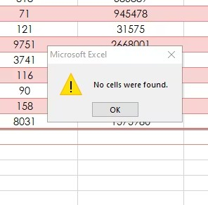

check null cells and duplicates values.

Slide 8
ANALYSIS DATA

Slide 9
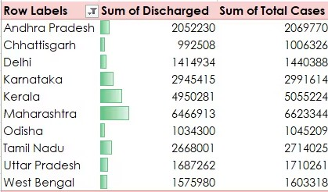
Helps visualize trends in total cases vs
recovery cases.

Slide 10
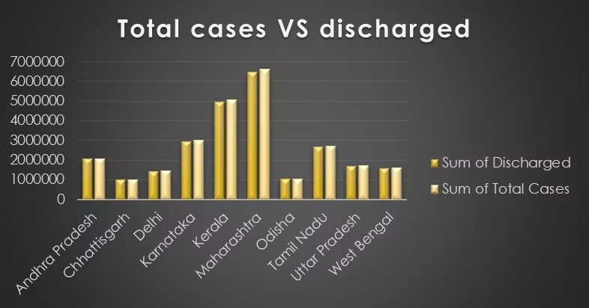
visualization

Slide 11
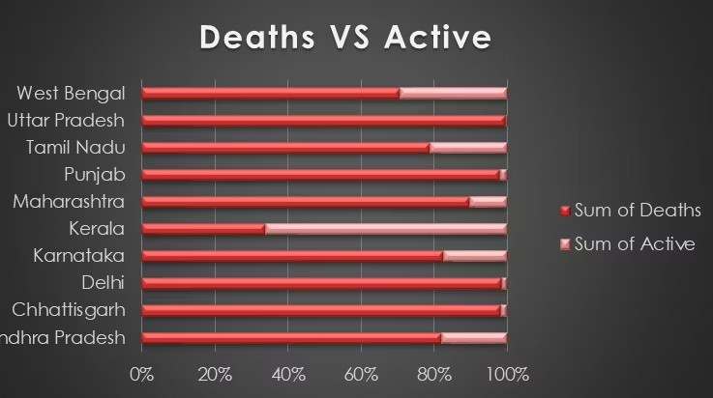
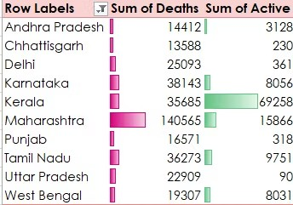
Helps compare different case types across states.
visualization

Slide 12
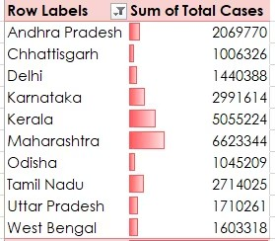
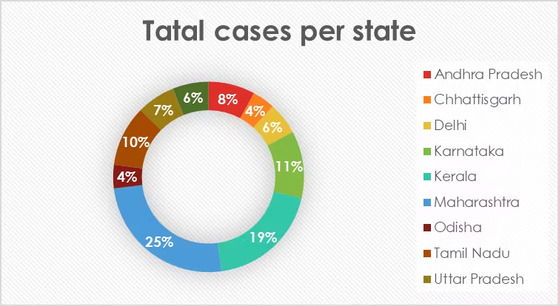
visualization
Helps us know total cases in every state.

Slide 13
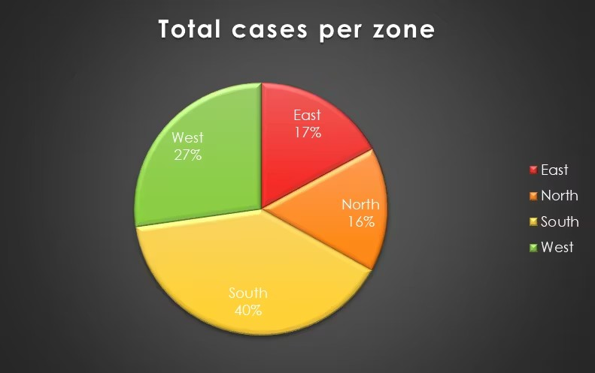
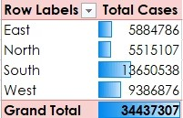
visualization
Helps us know total cases in every zone.

Slide 14
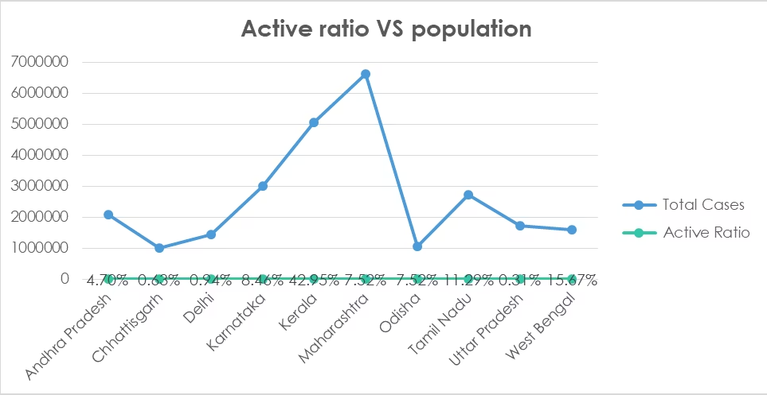
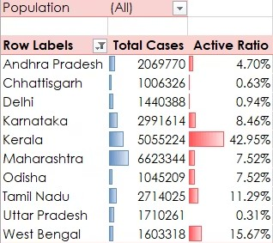
visualization
Shows how COVID-19 cases relate to population size.

Slide 15
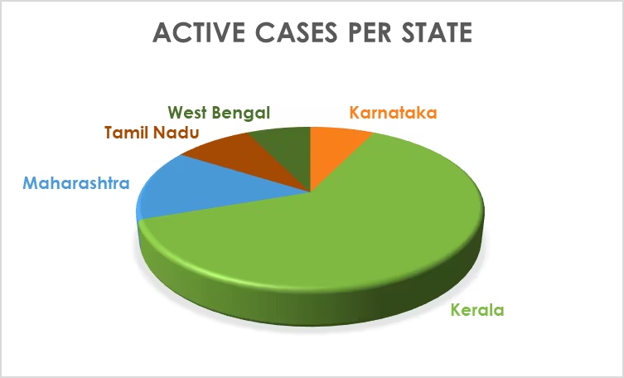
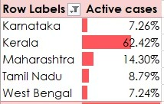
visualization
Shows active cases in every state.

Slide 16
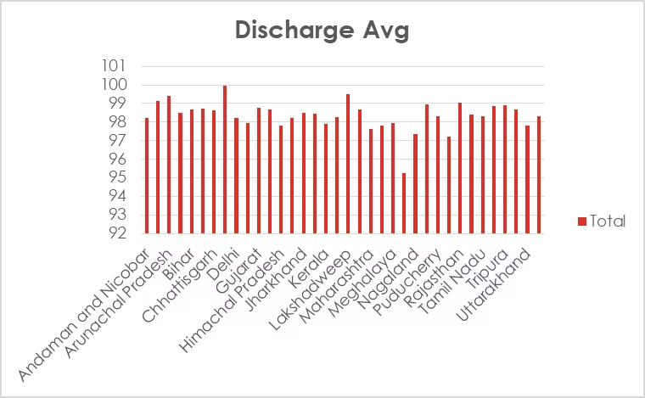
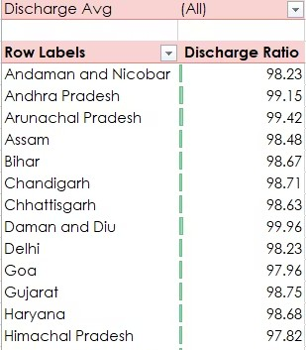
visualization

Slide 17
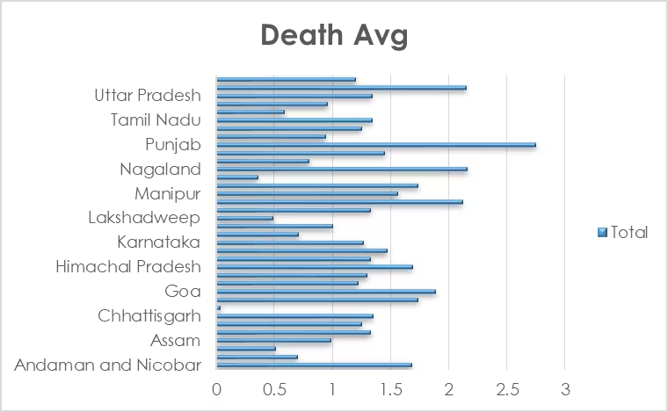
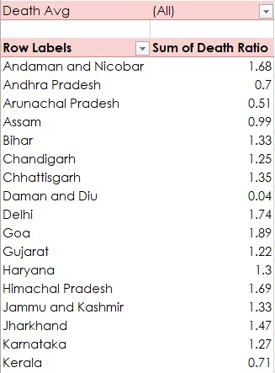
visualization

Slide 18
Key Insights:
Recovery vs. Fatality: Most states have a high Discharge Ratio (near 99%), indicating strong recovery rates.
Active Cases Are Low: The Active Ratio is mostly below 1%, meaning the pandemic is under control.
Death Rate Variability: Some states have a higher Death Ratio than others, correlating with the "Above Average" Death Avg category.
Population Impact: Heavily populated states (like Andhra Pradesh, Bihar) report high case numbers but also high discharge rates.

Slide 19
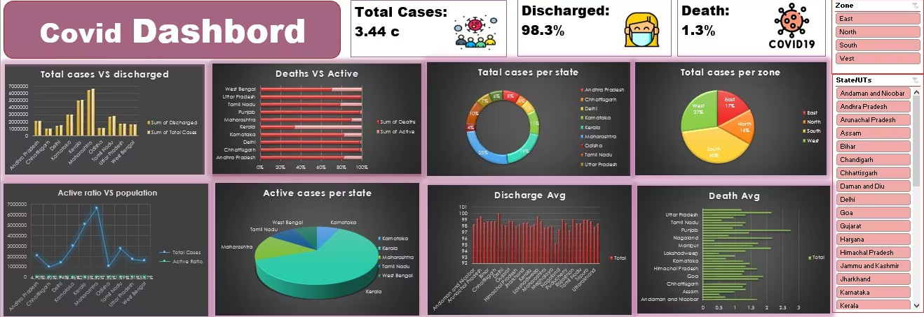

Slide 20

THANK YOU
BY Shrouk Hassan

